Slide 1

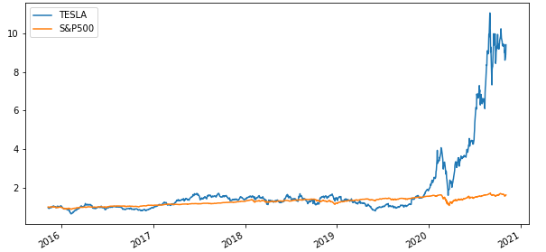

YOUR NEXT INVESTMENT Why Not Tesla ?
Team Members: Minh Tran, Syed Naqvi, Rodrigo Guazzelli , Hsuan Liu, Abdullah Mamun
2020.11
Notes:
Team Members:
Minh Tran
Syed Naqvi
Rodrigo Guazzelli
Hsuan Liu
Abdullah Mamun

Slide 2
Data Sources
1
Growing Industry
Market size, CAGR of EV market
Yearly sales of EV vs gas vehicle
EV sales portion vs New car sales
Diversification Effect
TSLA revenue breakdown by segment and region
2
3
Financial
TSLA Net Income, EBITDA, Capex, Profitability
TSLA valuation- comparable model
4
Stock Price Performance and Simulation
Historical stock price of TSLA vs S&P500 from 2015-2020
TSLA vs main competitors from 2015-2020
Monte Carlo simulation for the next 20 years
2

Slide 3


EV Market Outbreaks from 2020 to 2040
2020
2025
Current Status – On Road
500,000 e-buses
400,000 electric delivery vans
and trucks
184M electric mopeds, scooters
and motorcycles
Charging Units –
North America and Europe
500,000 charger units in 2022
Reach over 1.25 million by 2025
Passengers
Reach 10% EV sales
for lobal passenger in 2025
3
Source ：Bloomberg, Wood Mackenzie, NREL

Slide 4

EV Market Outbreaks from 2020 to 2040
2030
2040
EV Impact –
Americans Private Households Income
Each saves $ 255 to $791 per year
Total private benefits range from
$18.6 to $27.3 billion by 2035
for main Aggressive & Low Cost scenarios
Expected EV Status
500 million EV passenger on the road
31% world's passenger cars are electric
Passengers.
Increase by 58 globally
Passengers
Increase by 28% in 2030 globally
Green Hydrogen Costs
Fall by up to 64%
4
Source ：Bloomberg, Wood Mackenzie, NREL

Slide 5
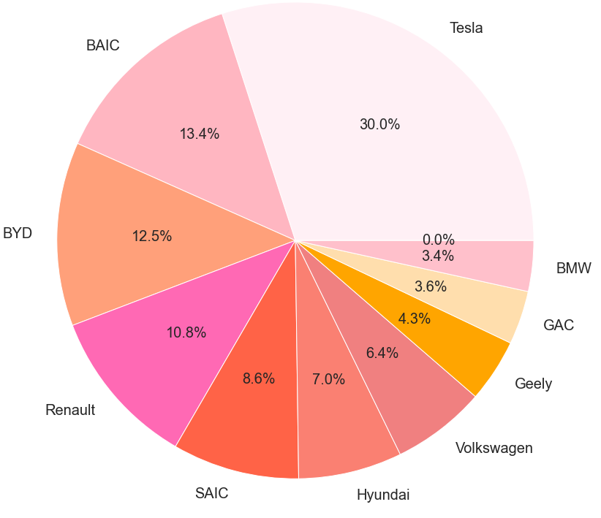
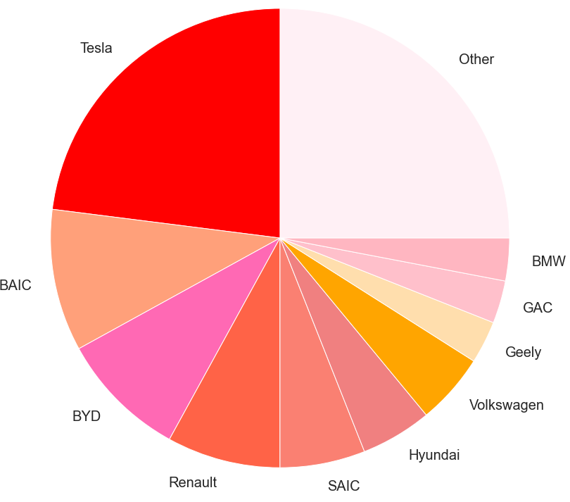
EV Market Snapshot in 2019 – TSLA leading in both sale and market share
Top 10 EV Automotive Makers by Sales in 2019
Market Share of All-electric Car in 2019
25%
5
Source ：IBIS World, Deloitte EV Market Report, Industry Report
Notes:
TEV/Total Revenues LTM – Latest 14.3
TEV/EBITDA LTM – Latest 90.8
Industry 50th percentile
TEV/Total Revenues LTM - Latest 1.2 TEV/EBITDA LTM - Latest 16.6

Slide 6
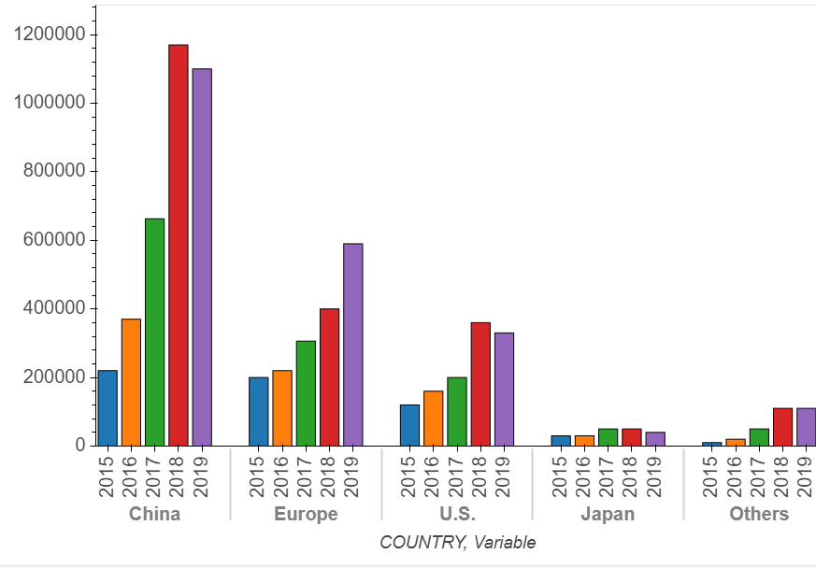
EV Market Snapshot in 2019
Global EV Sales from 2015 to 2019
Need to add sth here
25%
6
Source ：Industry Report, Equity Research Report,

Slide 7
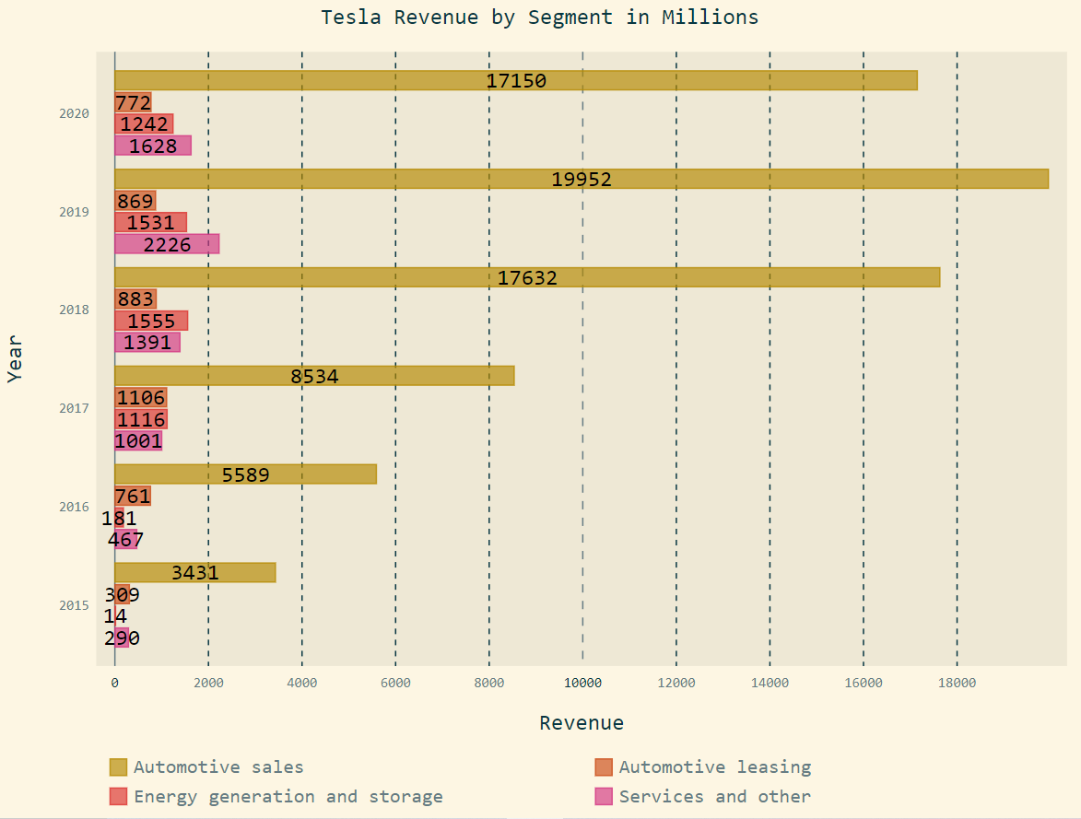
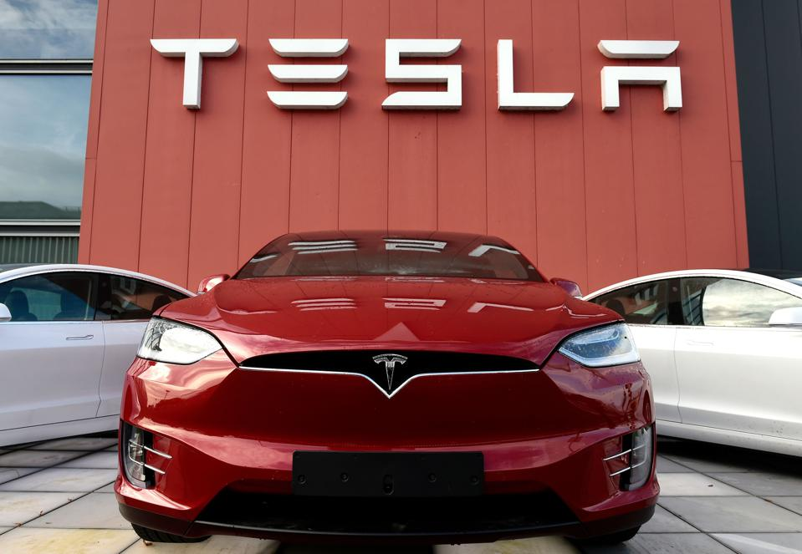
TSLA-Business Diversification
Revenue Breakdown by Segment
Tesla Possible Future Incomes
In-house car insurance
Robo-taxi
Ride-hailing Vehicles and Services
FSD & Software as a service
Industry batteries
Computer chips for FSD
7

Slide 8
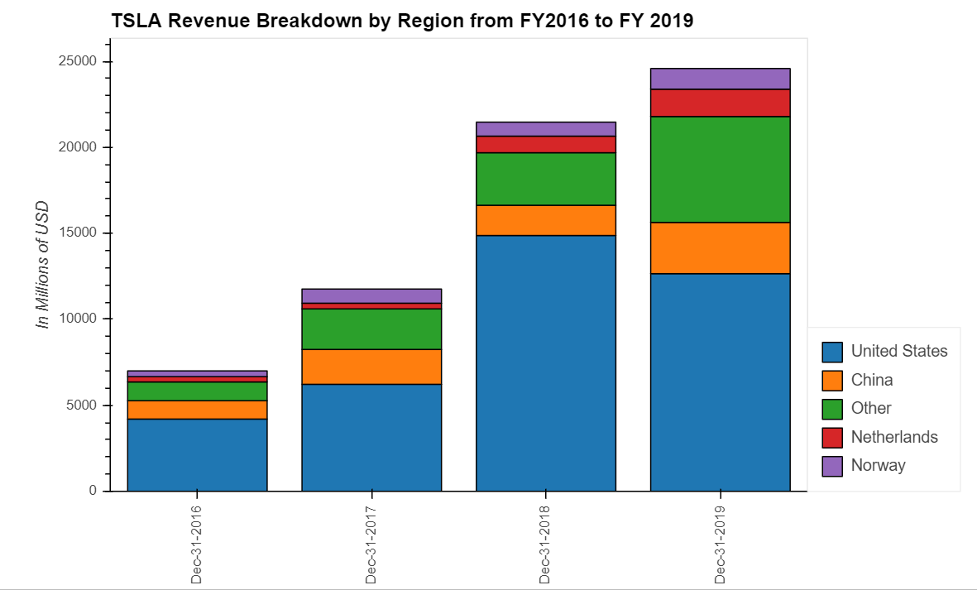
TSLA-Business Diversification
Revenue Breakdown by Region
Need to add sth here
8
Source ：FactSet, Equity Research Report, FS

Slide 9
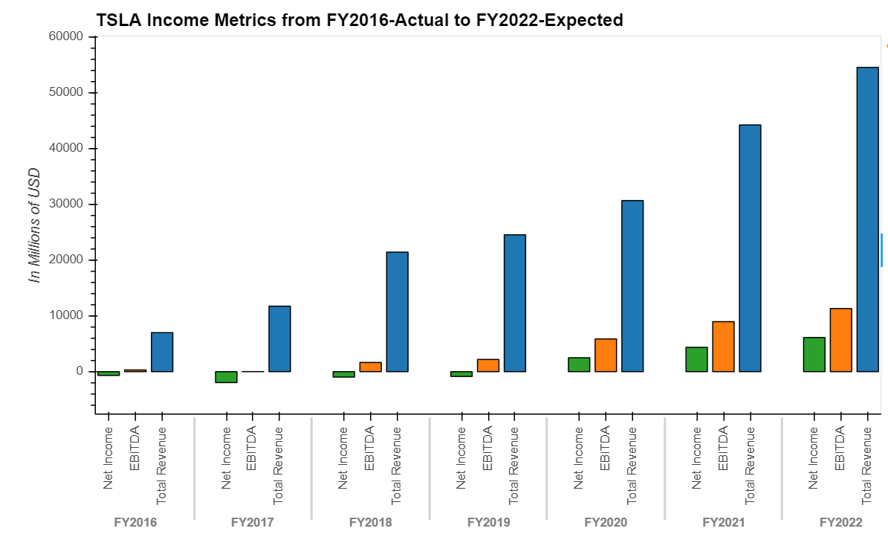
TSLA-Financial Analysis
Income Metrics- Net Income, EBITDA, Revenue
Profitability
Revenue CAGR 36.89% from FY2016 to 2019
EBITDA CAGR 64.12% from FY2016 to 2019
Net Income has turned positive in FY2020
Capex growth trend with cumulative 12 months YoY of 94.62% to $ 2,423 M as of Sep 30 2020
Average Capex from FY2016 to 2020 LTM is $2237.4 M
Revenue CAGR 36.89%
EBITDA CAGR 64.12%
9
Source ：FactSet, Equity Research Report, FS
Notes:
(1,634.9) (1,440.5) (4,081.0) (2,319.0) (1,432.0)

Slide 10
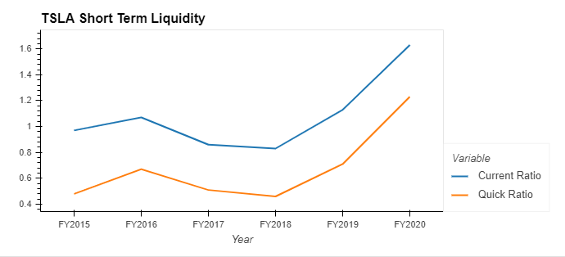
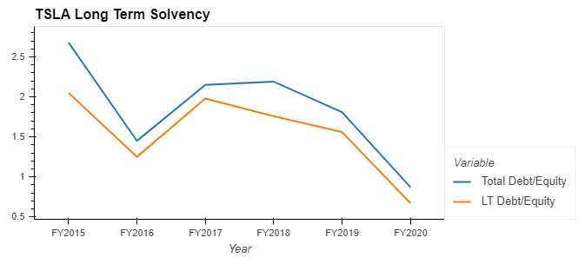
TSLA-Financial Analysis
Short-term Liquidity Analysis
Long-term Solvency
Current and quick ratio trend up, indicating TSLA’s ability to meet short-term liabilities with short-term assets
Leverage of TLSA has a down trend and the likelihood of default has been decreasing
10
Source ： CapitalIQ, FS

Slide 11
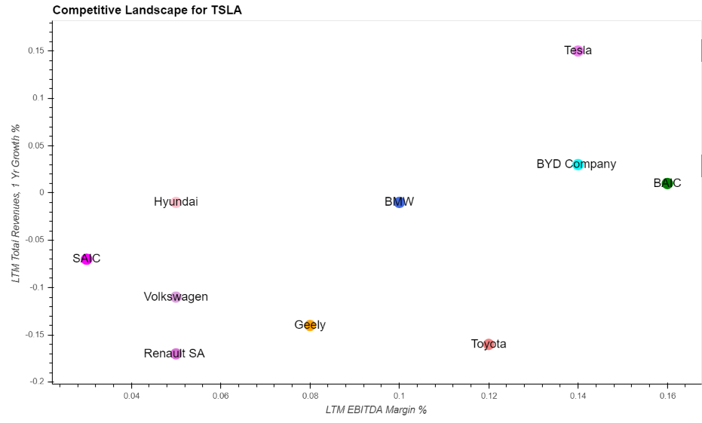
TSLA-Competitive Landscape
First Tier Company - TSLA
Selected Competitors
Toyota
BMW
BAIC
Volkswagen
BYD Company
SAIC
Renault SA
Hyundai
Geely
Tesla
Highlights
TSLA has EBITDA margin around 14% and revenue YoY of 15%, serving as an industry leader
Compared to industry median of 9% EBITDA Margin and -4% 1-year Revenues Growth, TSLA becomes competitive and first tier candidate
11
Source ：CapitalIQ, Equity Research Report, FS
Notes:
https://insideevs.com/news/396714/world-top-10-plugin-automotive-groups-2019/
Toyota
BMW
BAIC
Volkswagen
BYD Company
SAIC
Renault SA
Hyundai
Geely
Tesla

Slide 12
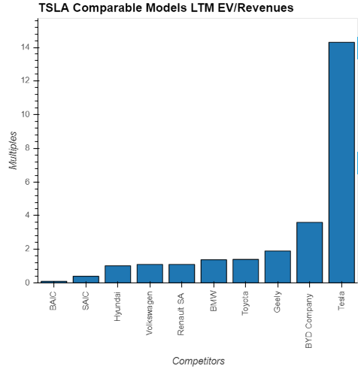
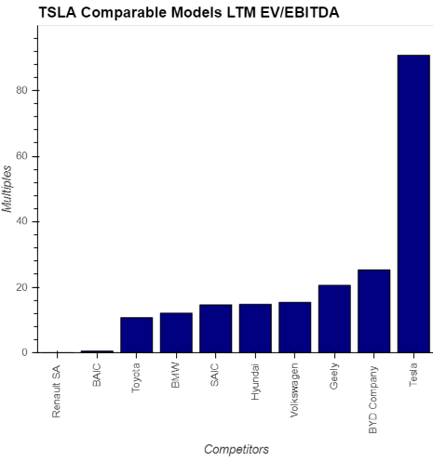
TSLA-Comparable Models
Valuation Highlights - EV/Revenues LTM is 14.3x
Valuation Highlights - EV/EBITDA LTM is 90.8x
Industry Median:1.24x
Industry Median:14.70x
12
Source ：CapitalIQ, Equity Research Report, FS
Notes:
TEV/Total Revenues LTM – Latest 14.3
TEV/EBITDA LTM – Latest 90.8
Industry 50th percentile
TEV/Total Revenues LTM - Latest 1.2 TEV/EBITDA LTM - Latest 16.6

Slide 13
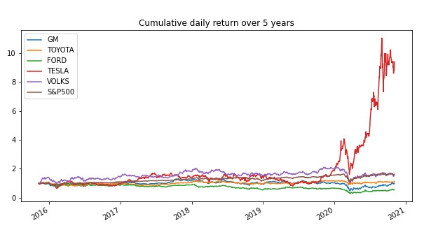
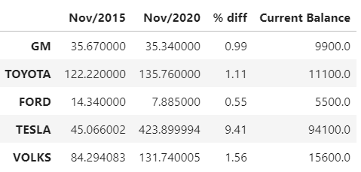
TSLA-Historical Price Analysis For The Last 5 Years
TSLA vs Competitors
Stock Price
If you had invested $10,000 in TESLA stock 5 years ago your current balance would be $94,100
13
Source ：Alpaca trade API / Yahoo Finance
Notes:
TEV/Total Revenues LTM – Latest 14.3
TEV/EBITDA LTM – Latest 90.8
Industry 50th percentile
TEV/Total Revenues LTM - Latest 1.2 TEV/EBITDA LTM - Latest 16.6

Slide 14
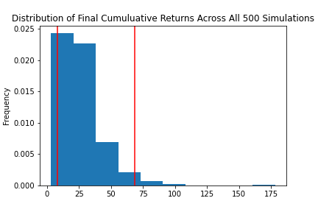
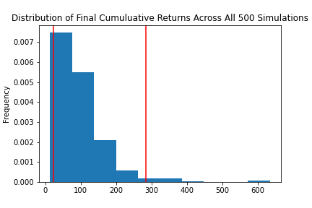
TSLA-Sensitivity Analysis For Next 20 Years
Monte Carlo Simulation Portfolio Without Tesla
Monte Carlo Simulation Portfolio With Tesla
With an initial investment of $10,000 in your portfolio you have a 95% chance it will be within the range of $82,972.21 and $683,666.61 over the next 20 years
With an initial investment of $10,000 in your portfolio you have a 95% chance it will be within in the range of $226,781.95 and $2,835,449.51 over the next 20 years
Portfolio = Apple, Alphabet, Johnson & Johnson, Berkshire Hathaway
14
Notes:
TEV/Total Revenues LTM – Latest 14.3
TEV/EBITDA LTM – Latest 90.8
Industry 50th percentile
TEV/Total Revenues LTM - Latest 1.2 TEV/EBITDA LTM - Latest 16.6

Slide 15
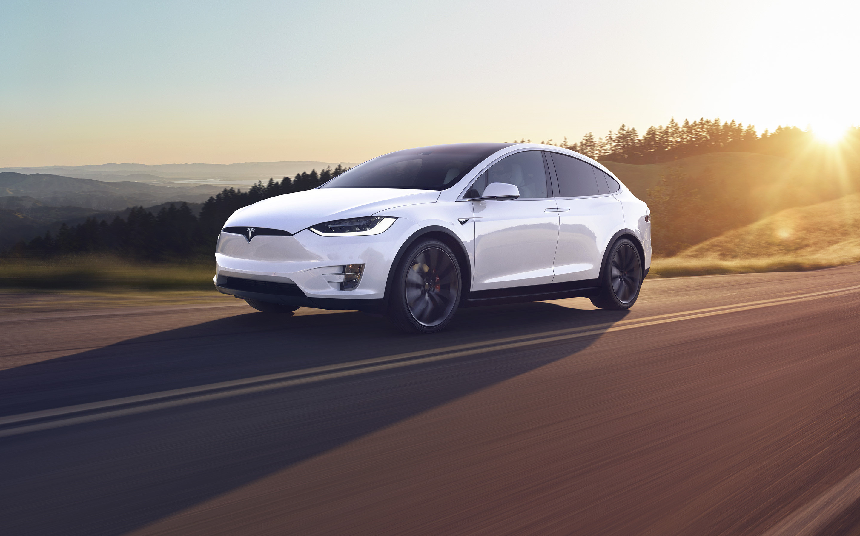
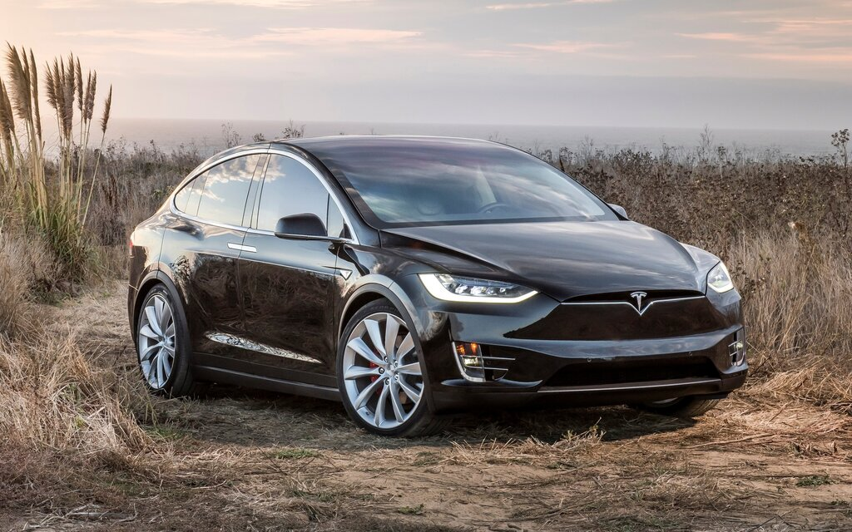
Conclusion – Investment Thesis Recap

Slide 16

Q&A Session
16

